Slide 1
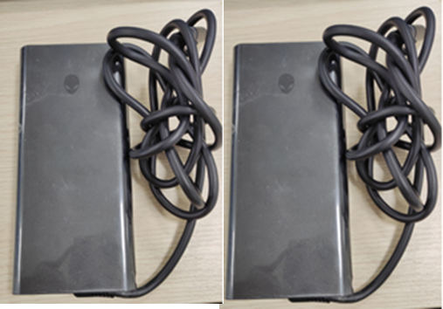
Characterize | Company Name: Chicony Power | Title: E5 360W NN34T AC adapter noise issue
 | Champion: CF Liu Date:2024/3/19 (update:4/2) | Description: 3/15 Chicony power received 1pc E5 360W sample from Malaysia which was complained noise issue by user. 3/21 Chicony Power got another sample from DELL Shanghai. Dell P/N: NN34T #1 PPID: CN-0NN34T-CH200-3CG-017T-A00 #2 PPID: CN-0NN34T-CH200-3CB-015U-A00 D/C:3CG (2023/ 12/16) 3CB (2023/12/12)
 | Members: CQS: Candy Zhu SQE: Wendy IPQC/QE: Chaes Cai IE: Yansong Tong MFG: Allison Wang PE: Plain Chen Sales: Steve RD: Hunter

Slide 2
Contain | Containment Actions: 1. Shipment record investigation : Till 2024/3/22 , Chicony Power has totally shipped 5,909pcs 2. Till 3/28, Finished goods stock of each site please refer to below: Total 2,016
Site | Q’ty (pc)
Wistron (CD) | 1,370
AMF-Nashville (US-低压) | 24
CCC(Xiamen) | 24
Compal (KS) | 144
Chicony Power Factory | 454

Slide 3
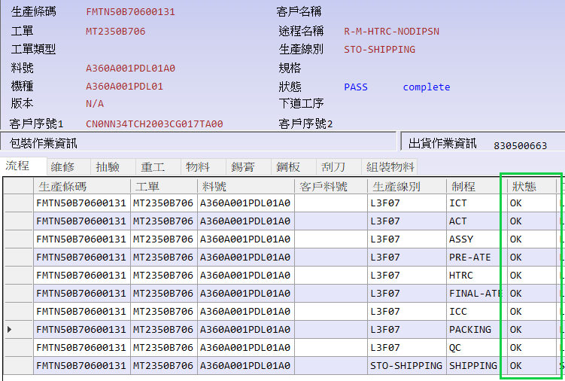
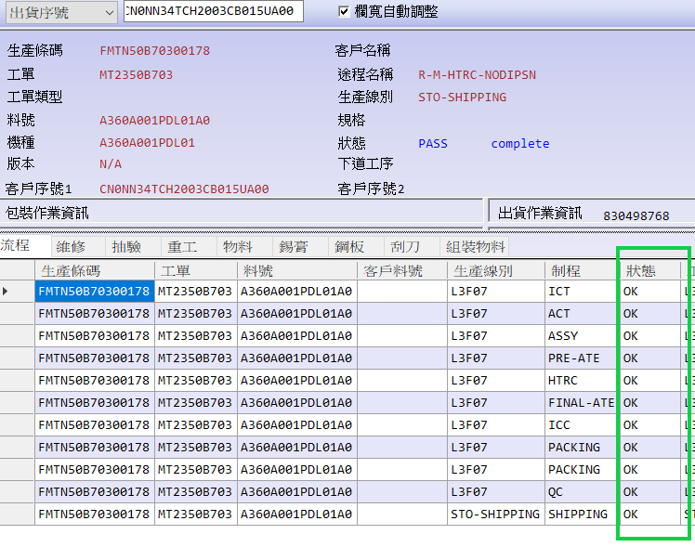
Cause | FA and Root Cause: 1.Check the SFCS record through by the PPID, both of these 2 samples have passed all test stations normally, no repaired record.

Slide 4
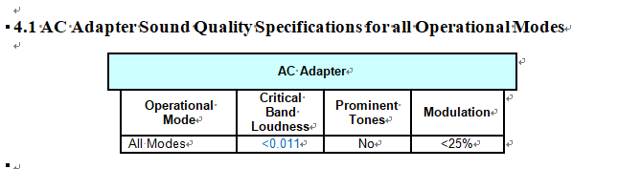
Cause | FA and Root Cause: 2. Listening the sample 2.1 in normal factory office, we can hardly hear the abnormal sound from adapters if the samples is not close to the ear. 2.2 in a quiet meeting room , also no abnormal sound was listened. Compare to stock , no difference was found. Voltage condition: city voltage Load condition : Star from 0V to full load 3. Sent samples to Taipei to test acoustic following DELL spec , result: PASS. DELL spec please refer to below:
Sample 1
Sample 2

Slide 5
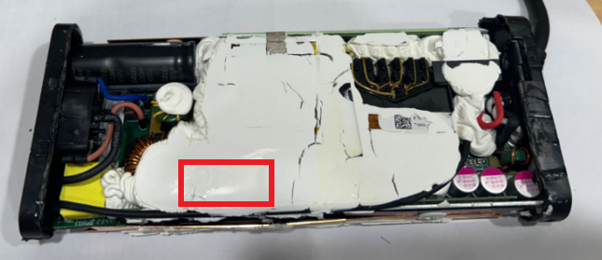
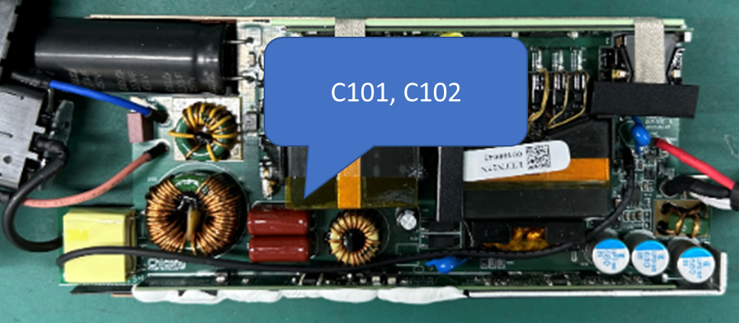
Cause | FA and Root Cause: 3. In order to duplicate the similar noise , we have tried inputting various waveforms at the AC input, and finally confirmed that louder noise will be generated when AC is distorted. 4. Further check the noise source, found it came from Pai Filter Cap.

Slide 6
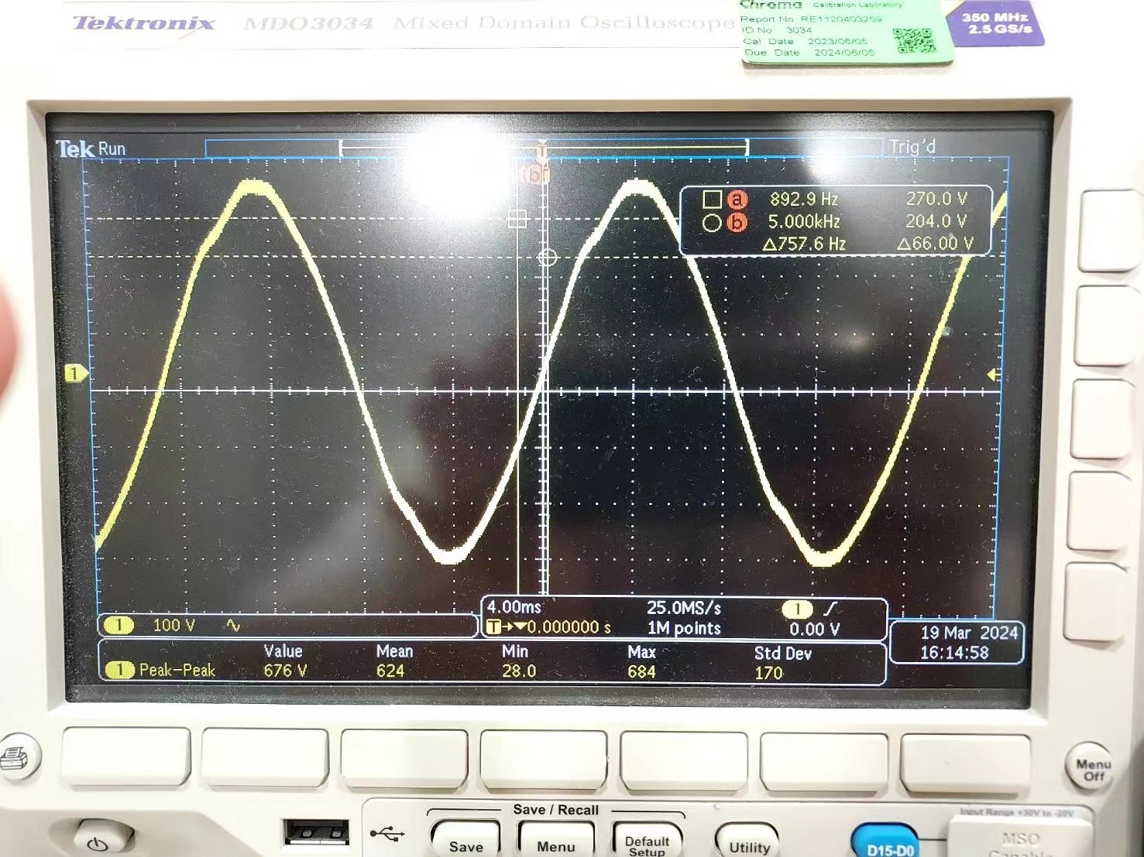
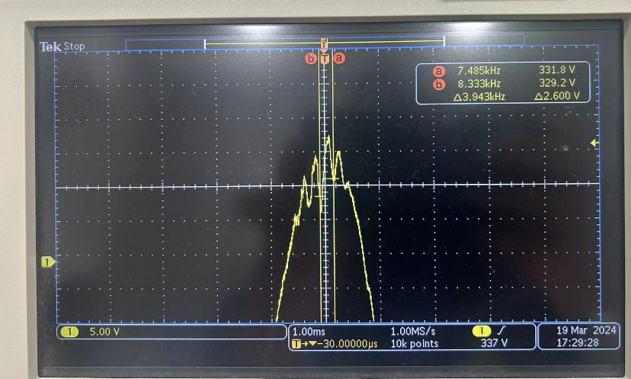
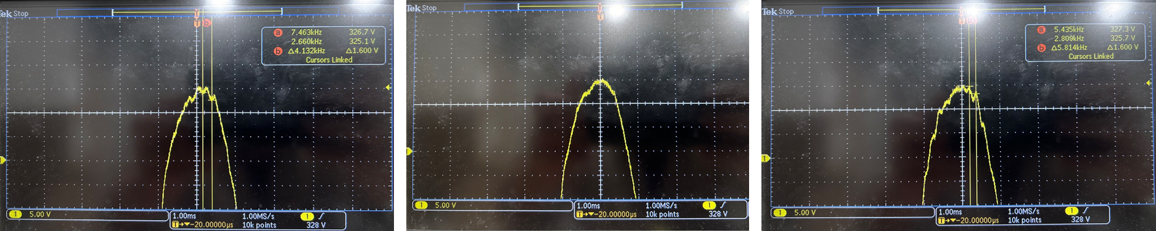
Cause | FA and Root Cause: 5. Measured AC waveforms in various places and confirmed that the actual AC is different. 5.1 Measured the AC waveforms at the homes of 15 colleagues in Taipei. Result: Noise frequency was captured at 1 of 15 colleague‘s home, noise frequency :3.94KHz
完整图
放大图: worst case

Slide 7
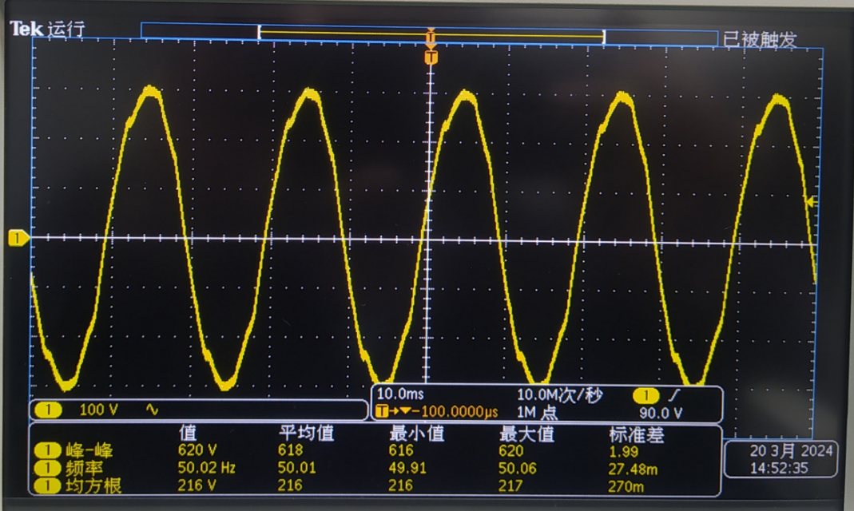
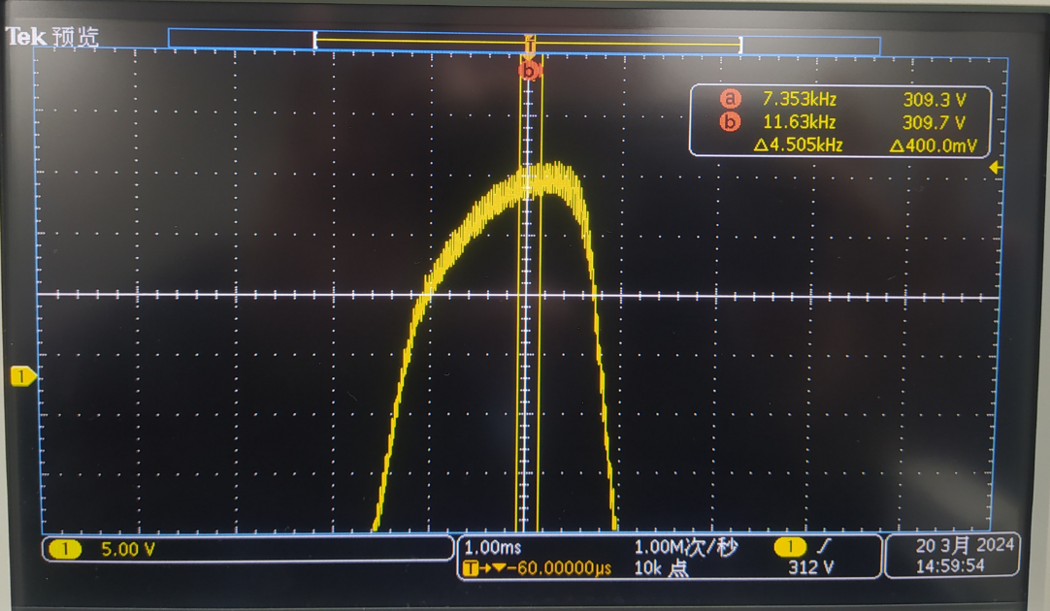
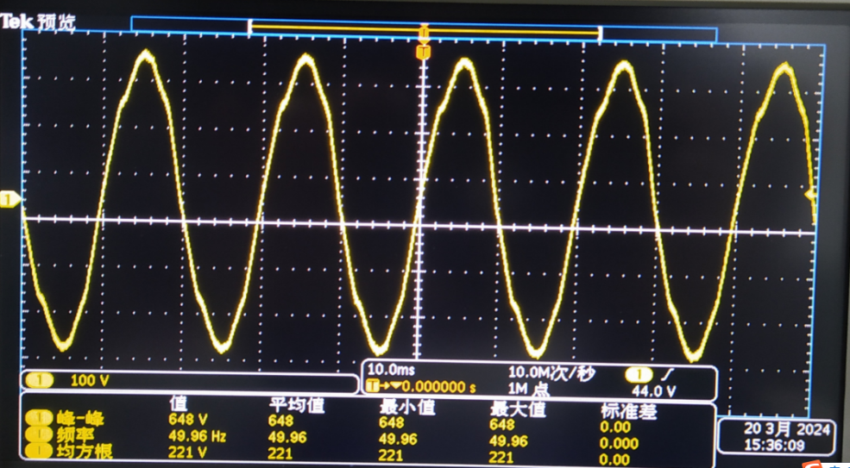
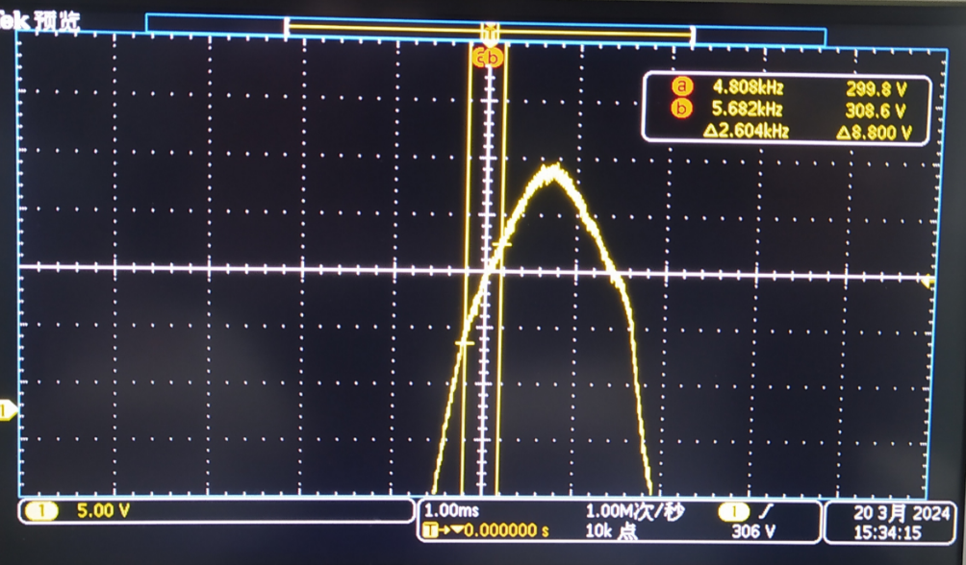
Cause | FA and Root Cause: 5.2 Measured the AC waveform of Chicony Power SZ factory office and production line, Result : no noise frequency was found.
完整图
放大图

Slide 8
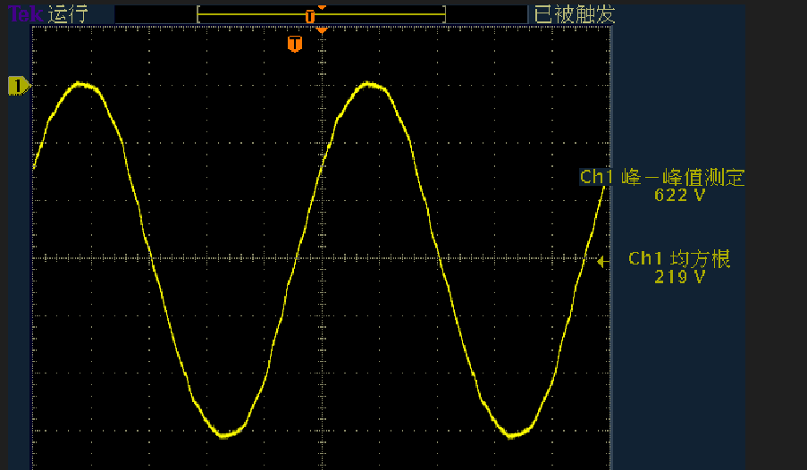
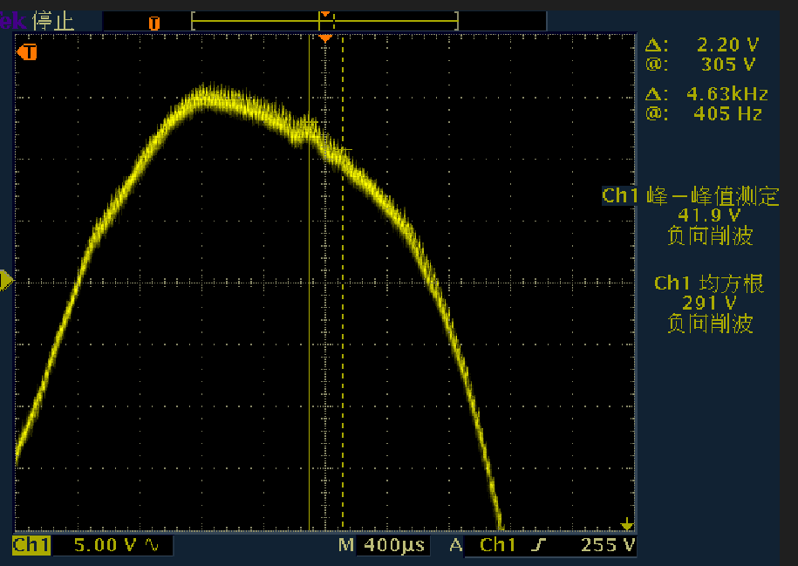
Cause | FA and Root Cause: 5.3 Measured the AC waveform of DELL (Shanghai) office, Result: a noise frequency was found in the morning, but it disappeared in the afternoon)
完整图
放大图
Site: Dell Shanghai Office(3/25 11:12am, captured a 4.6KHz input noise frequency)

Slide 9
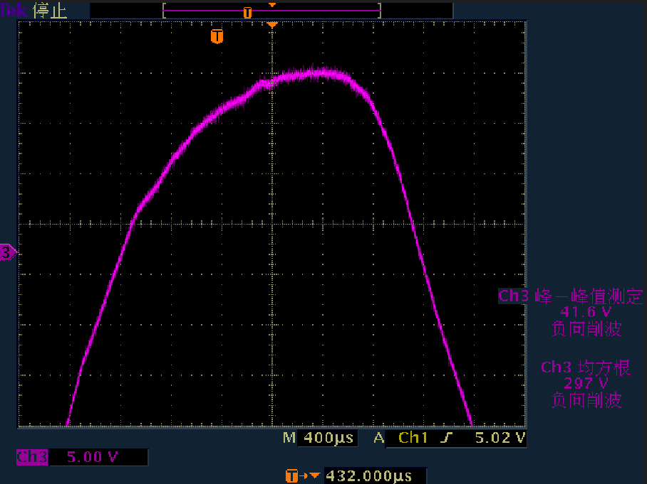
Cause | FA and Root Cause: 5.3 Measured the AC waveform of DELL (Shanghai) office, Result: no noise frequency was captured. Note* even at the same location in the same place, AC will be different at different time. but listening the adapter, no abnormal sound was listened.
Site: Dell Shanghai Office(3/25 1:26PM, no input noise frequency was found )

Slide 10
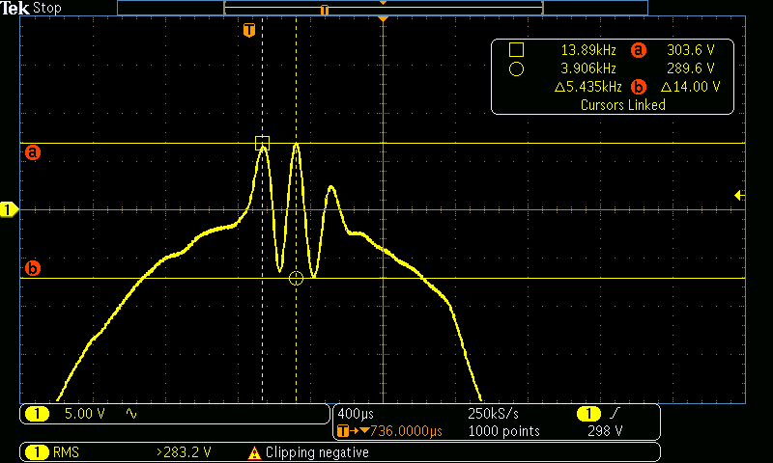
Cause | FA and Root Cause: 6. Based on the real case , we chose a worst-case condition (measurement 1) to simulate AC noise as following: The simulation waveform is worst than actual AC line noise.
Measurement 1
C
A
 | Actual AC line noise | Simulated identical noise (DS21-2)
A-B point | 8V | 13V
B-C point | 12V | 13V
C-D point | 7V | 14V
Frequency | 3.94KHz | 5.485KHz
B
D
Worst condition
Simulation noise
C
A
B
D
From AC source

Slide 11
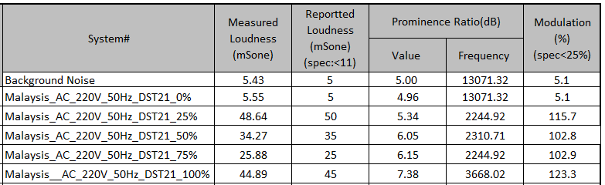
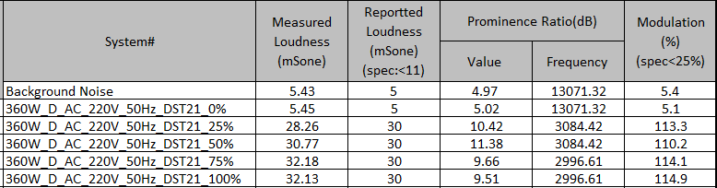
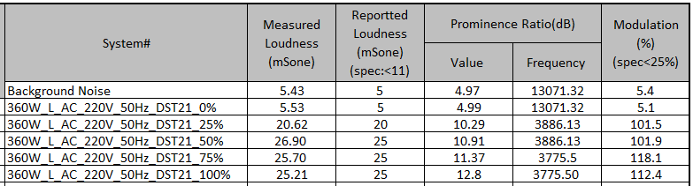
Cause | FA and Root Cause: 7. Use the same condition of DST21-2(AC distortion waveform) to test samples from different suppliers, result: the samples of 3 suppliers all failed the spec under AC distortion condition. Chicony Power: Reported loudness: Max:50, Min:5, Avg:32 D Company: Reported loudness: Max:30, Min:5, Avg:25 L Company : Reported loudness: Max:25,Min:5, Avg:20

Slide 12
Cause | FA and Root Cause: 8. Compare the Pai Cap of each adapter suppliers’ , result as below:
Supplier | Capacitance
Chicony Power | 2.2uF * 2PCS
D company | 1.5uF * 2PCS
L company | 1.5uF * 2PCS

Slide 13
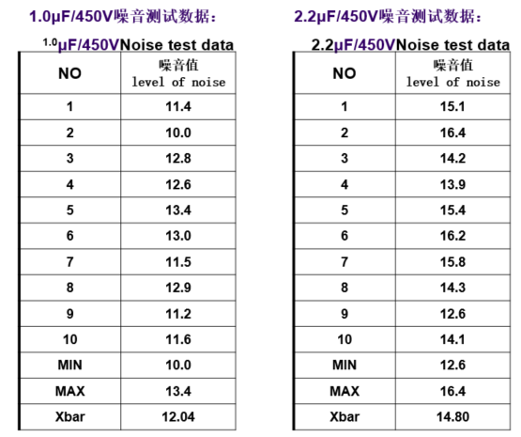
Cause | FA and Root Cause: 9. Component level noise test with microphone: 9.1 Test the noise of capacitors with different capacitance values. Result: the larger the capacitance value, the louder noise.

Slide 14
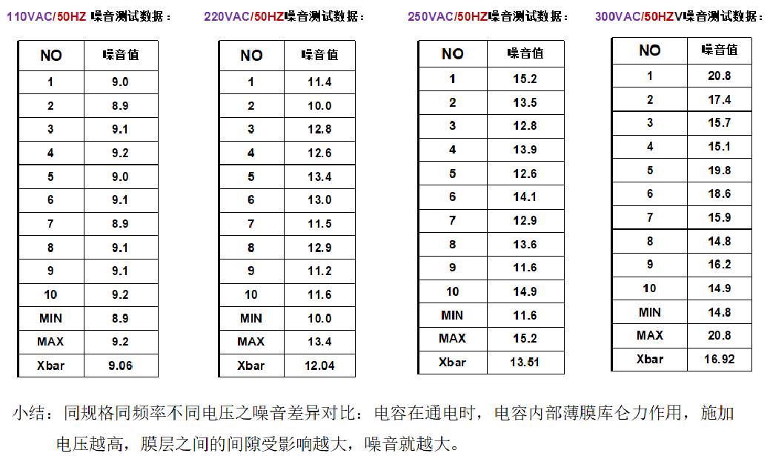
Cause | FA and Root Cause: 9. Component level noise test with microphone: 9.2 Test the noise of capacitors of the same specification at the same frequency but with different input voltage conditions. Result: the larger input voltage , the louder noise (refer to table 2)

Slide 15
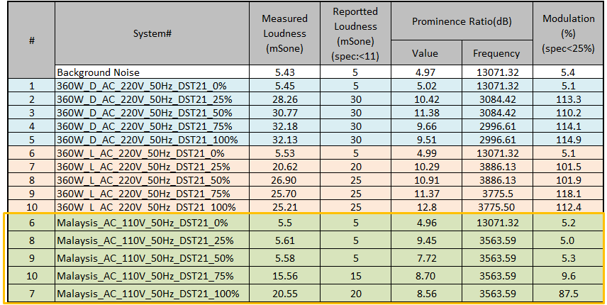
Cause | FA and Root Cause: 10.Finish goods level noise test : Take the same field returned sample and test the noise under high and low voltage conditions respectively , then input the same AC distortion waveform(DST21). Result: the larger voltage, the louder noise.
Field return sample test under low voltage
Reported loudness: Max:20, Min:5, Avg:10
Field return sample test under high voltage
Reported loudness: Max:50, Min:5, Avg:32

Slide 16
Cause | Conclusion: Based on the above analysis, we concluded that : The returned samples can pass DELL Acoustic Spec; 2. The product will generate the noise when AC is distorted, if the distortion is small, the chance of the product noise will also be small. If the distortion is over much , then the louder noise will be found. 3. The noise source is from Pai Cap and the large capacitance value, the louder noise. The larger input voltage, the louder noise. 4. Refer to the result of the above verifications, we judge that the existing FG inventory can be shipped to low-voltage countries to avoid similar customer complaints.

Slide 17
Correction | Continue improvement: 1. For continuing improvement, Chicony power will replace the current Pai filter Cap with with strong noise resistance to enhance the product’s performance regarding noise. Cut in schedule as below: Owner: EE/Benson,PM/Vicky Duedate:5/2
Items | Complete Date
DQA test (Bench &EMC&De-rating) | 4/12
System test | 4/24
DIDT | 4/24
Risk assessment | 4/25
ECR submit | 4/25
ECR Release | 5/2

Slide 18
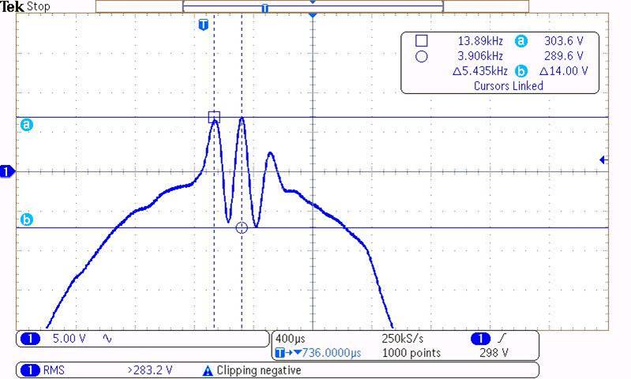
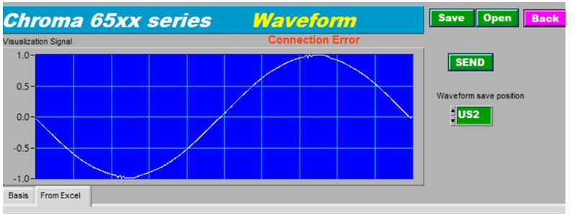
Correction | Continue improvement: 2. Chicony Power will add following distortion AC input waveform to the normal acoustic test for the new case in the future. Owner: EE/Benson, Complete date:4/1

Slide 19
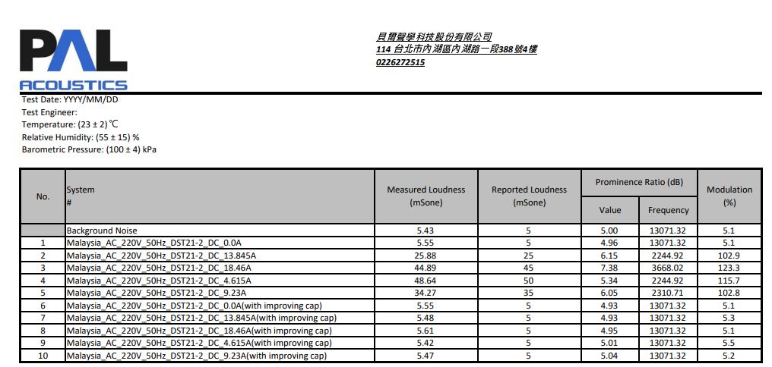
Correction | Continue improvement: Verification: Checked the noise under same AC distortion condition, below result shows when we changed the Pai filter, the noise performance can be improved greatly.
Closure | Prepared by: Candy Date: 2024/3/26 (update:4/2) Reviewed by: CF Date: 2024/3/26 (update:4/2)
before
After

